Slide 1
Devquery
GROUP NO:-1
Team members:
Miftahul Jannat 011-151-136
Sakib Shahriar Khan 011-143-138
A S M Morshedur Rahman 011-143-006
Fariha Hossain 011-143-017
Shakim Ahamed 011-143-066

Slide 2
Outline
Project proposal
Main objective
System Study
Benchmark Products
Feature Comparison
Feature List
Proposed Features
Sitemap
Flowchart of features
Ui design
Moqup
System Design
Structure Design
DFD
Design by UML
Use Case Diagram
Context Diagram
Activity Diagram

Slide 3
Project Proposal:
DevQuery is an online community for developers.

Slide 4
Main objective

Slide 5
Features
Proposed | Implemented
Login | 
Ask | 
Search | 
Follow | 
Chat | 
Post Tag | 
Community | 
Bidirectional Voting | 
Notification | 

Slide 6
Benchmark products:
Hashnode
Stack Overflow
Geeklist
dev.to

Slide 7
Features of Benchmark products

Slide 8
Hashnode
Login
Post
Search
Follow
Chat
Communities
Notification

Slide 9
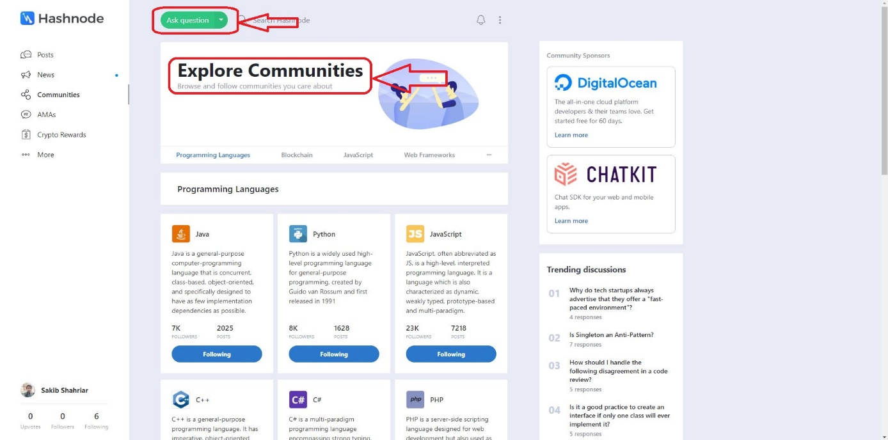
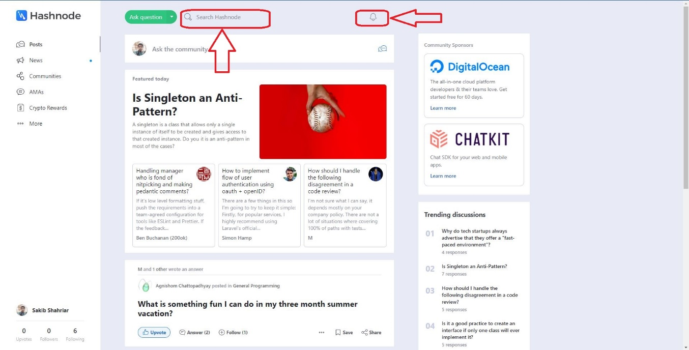
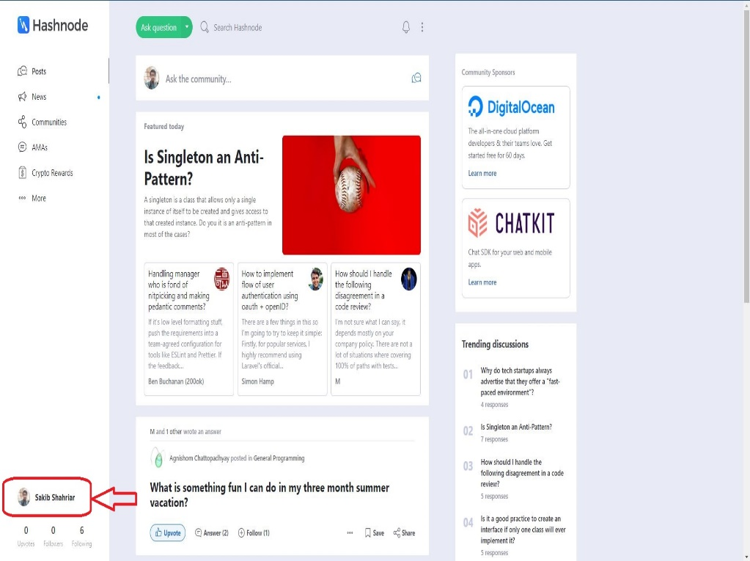
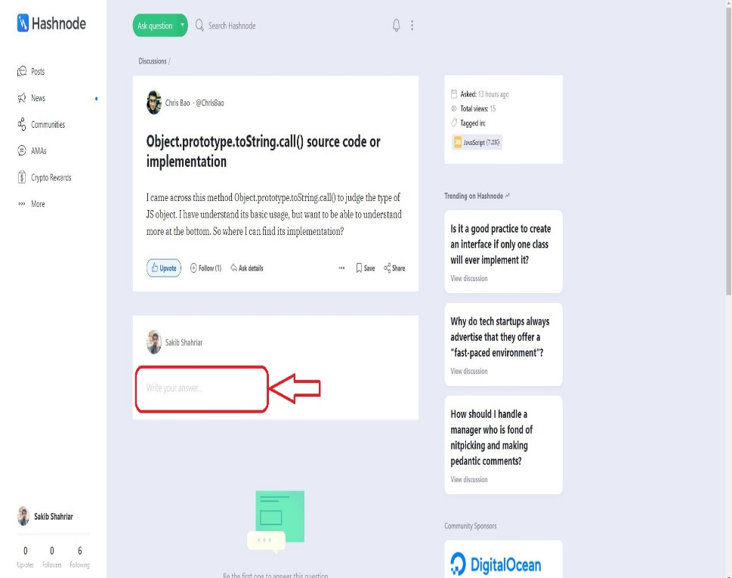
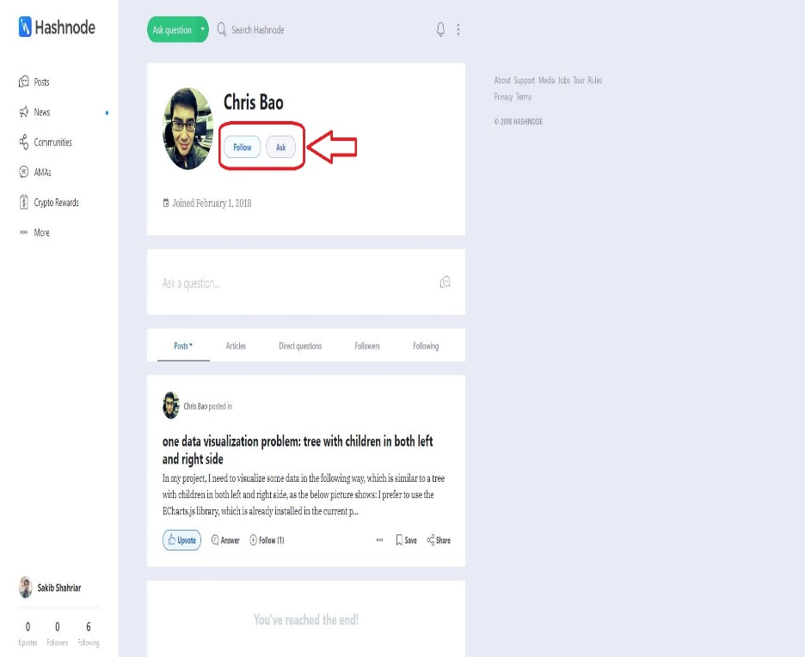

Slide 10
Stack Overflow
Login
Post
Search
Post tag
Bidirectional Voting
Notification

Slide 11
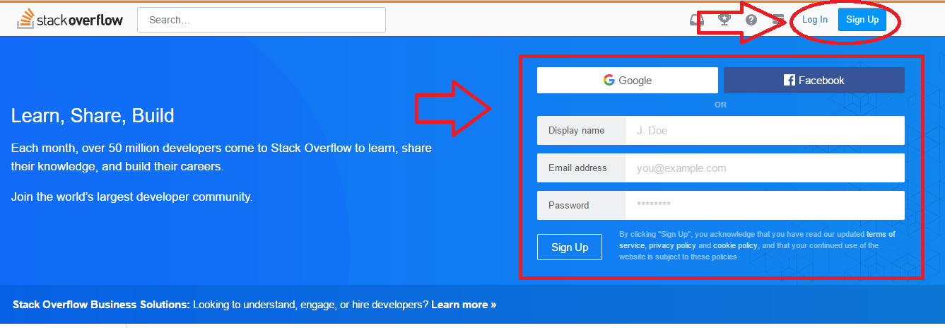
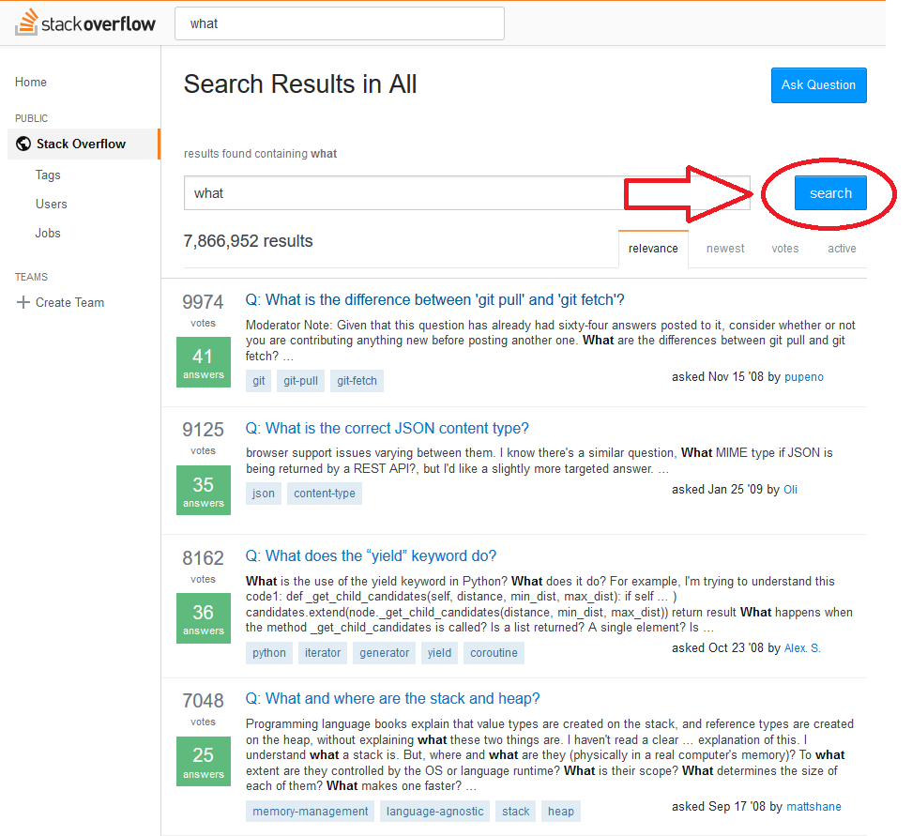
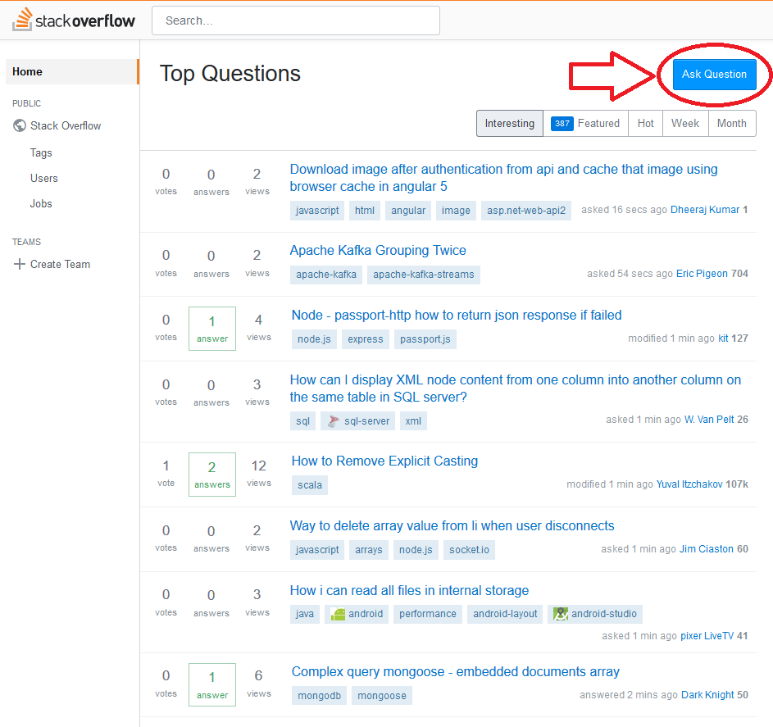
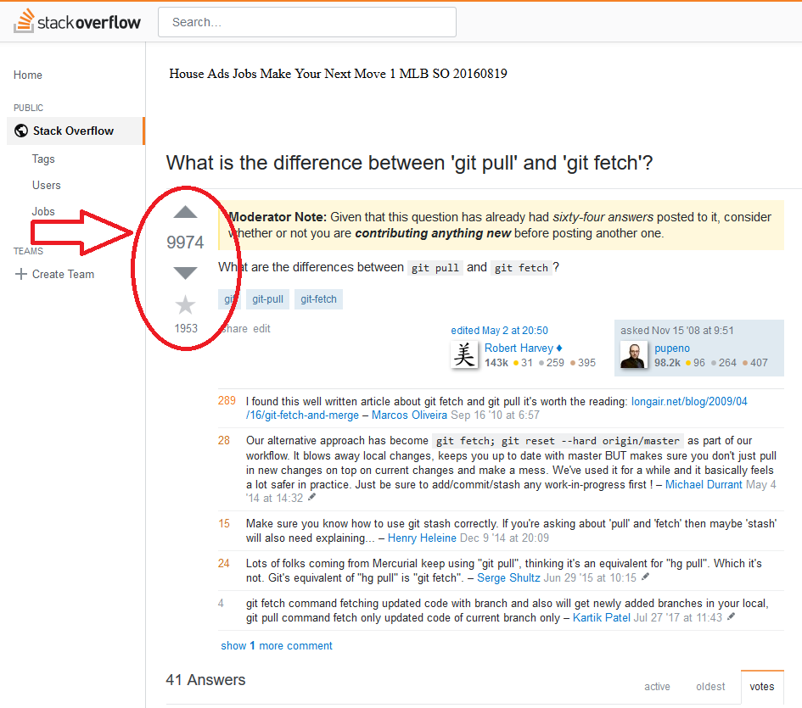

Slide 12
Geeklist
Login
Post
Search
Follow
Chat
Communities
Notification

Slide 13
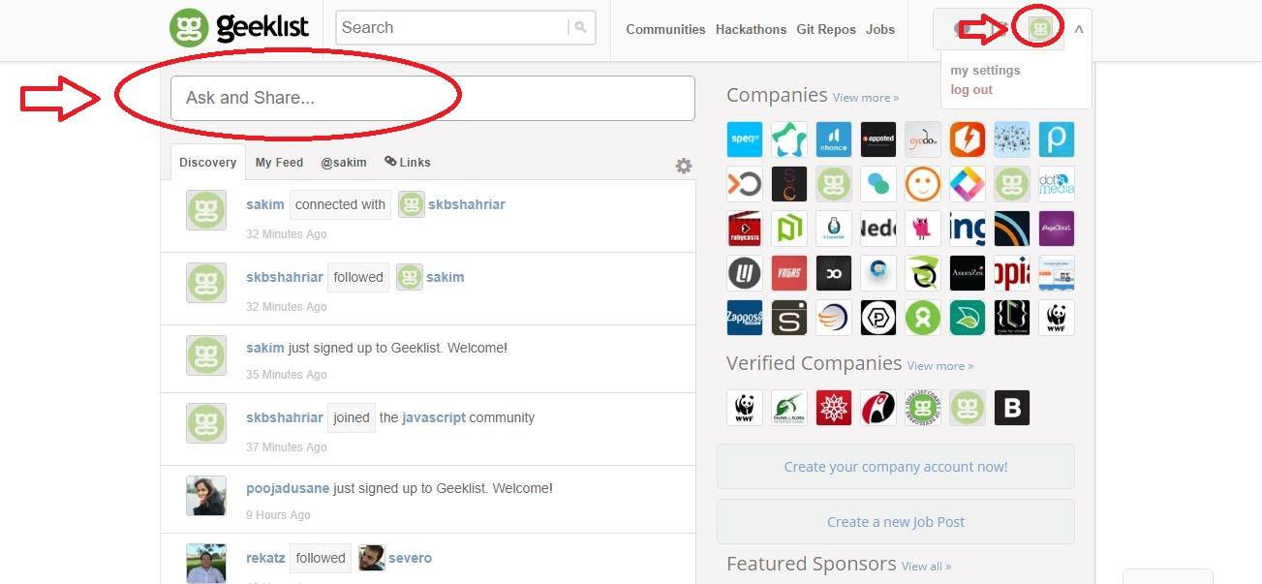
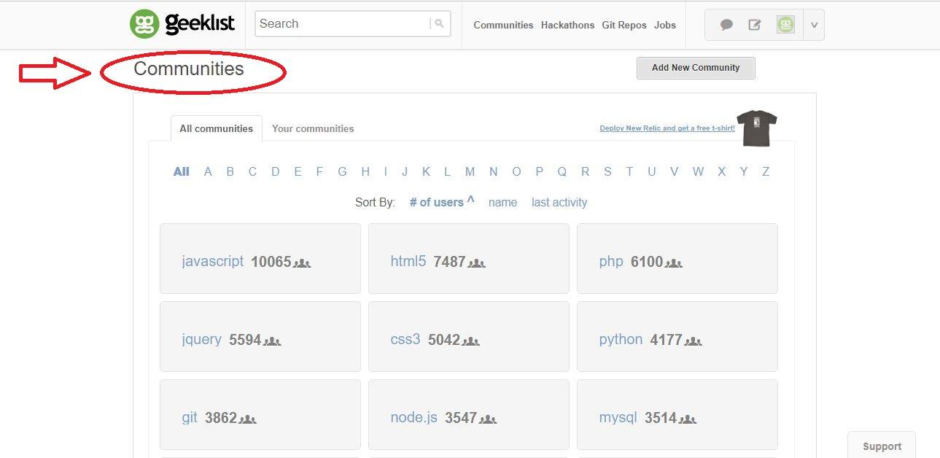
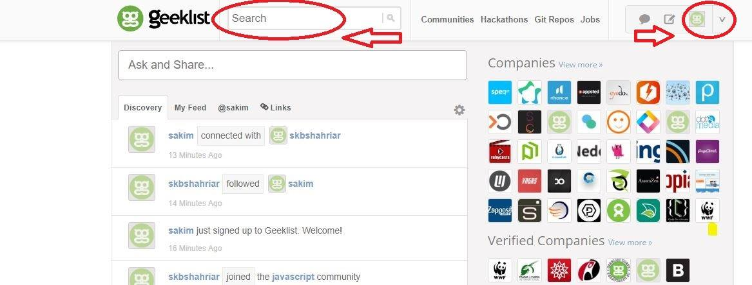
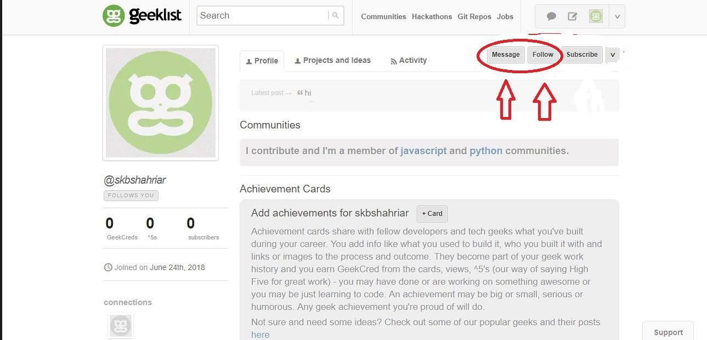

Slide 14
Dev.to
Login
Post
Search
Follow
Notification

Slide 15
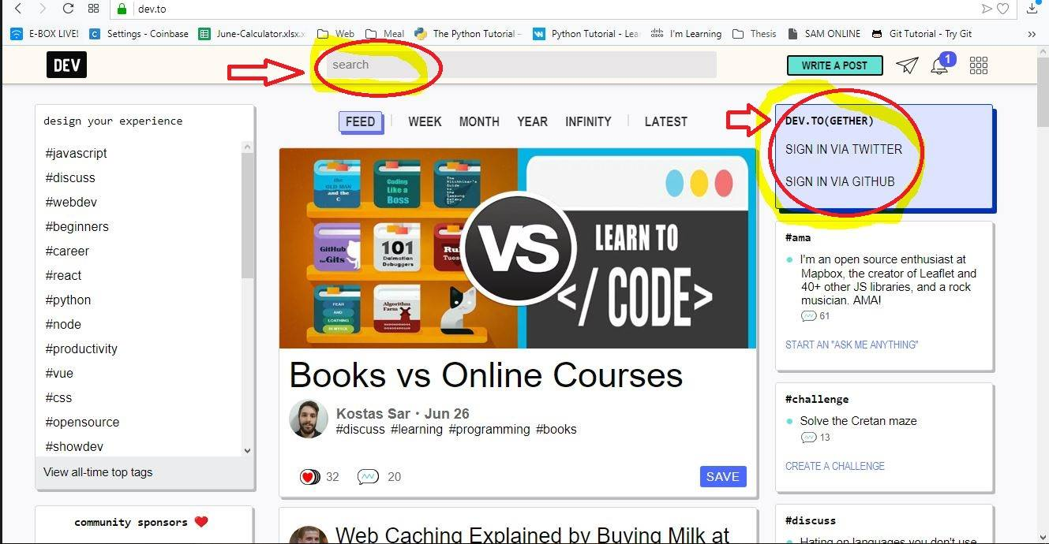
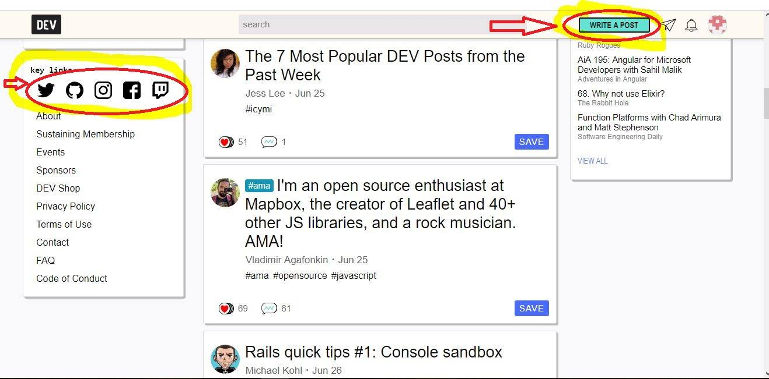
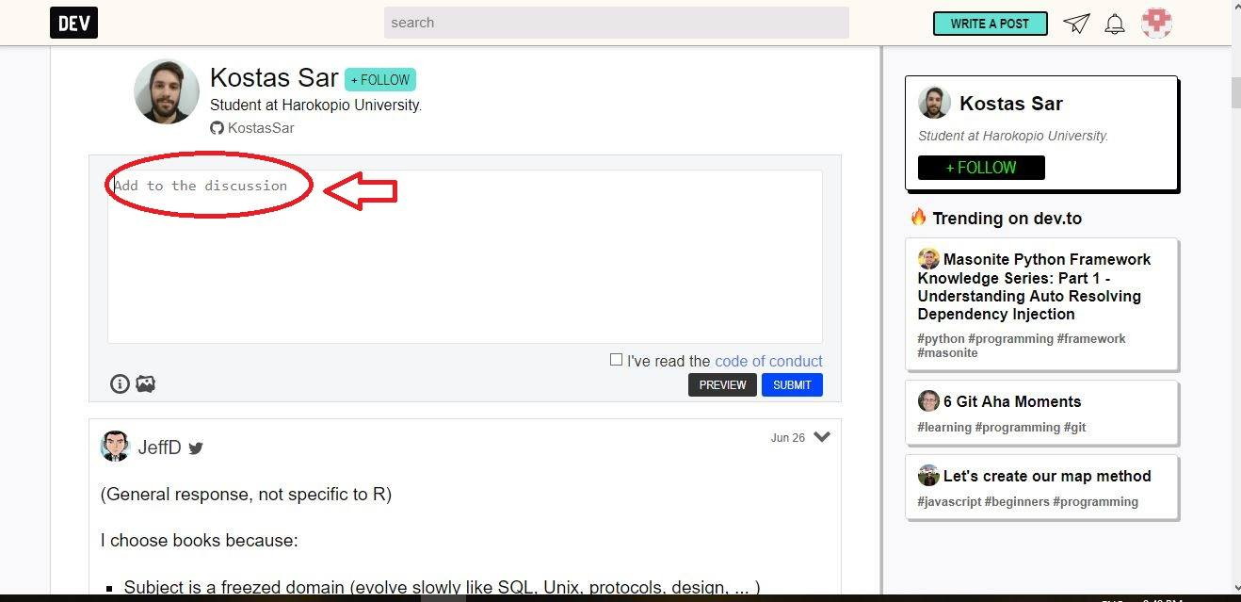
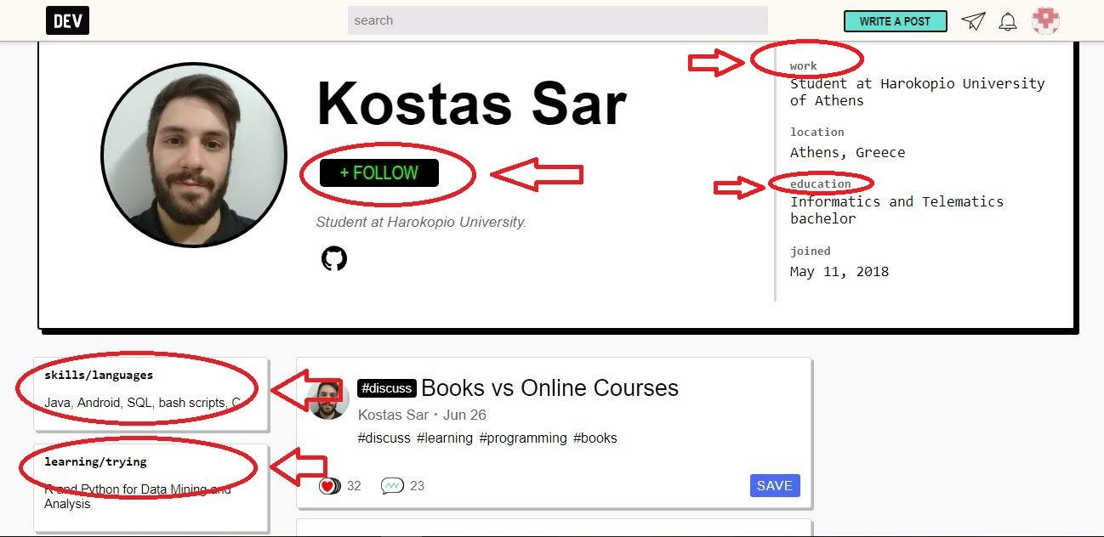

Slide 16
Links
https://hashnode.com/
https://stackoverflow.com/
https://geekli.st/
https://dev.to/

Slide 17
Feature comparison & Proposed Features

Slide 18
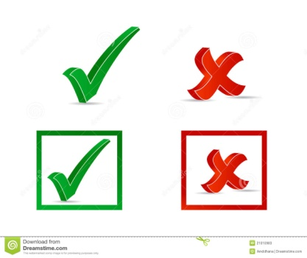



Features | Hashnode | Stack Overflow | Geeklist | dev.to | DevQuery
Login
Ask/Answer
Search
Follow
ASK/Chat
Post tag
Communities
Bidirectional Voting
Notification

Slide 19
Proposed Features
Login
Post
Search
Follow
Chat
Post tag
Community
Bidirectional voting
Notification

Slide 20
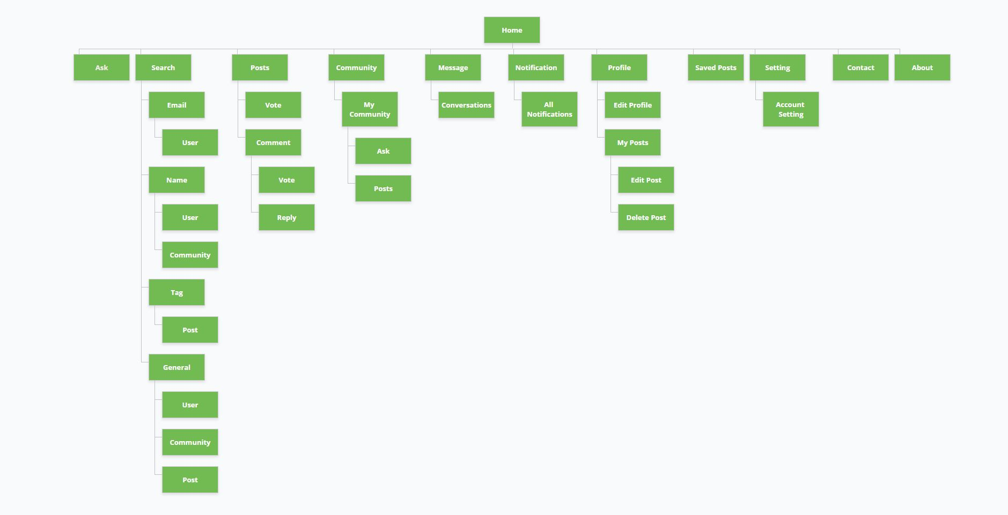
Sitemap

Slide 21
Flowchart of Features

Slide 22
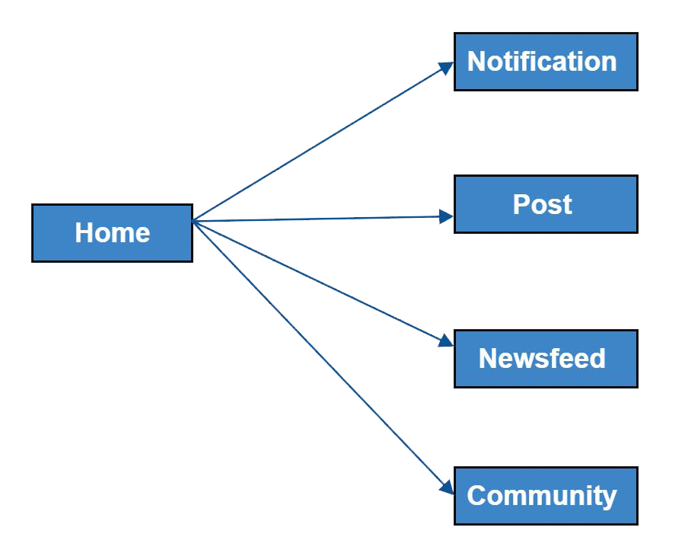
Home

Slide 23
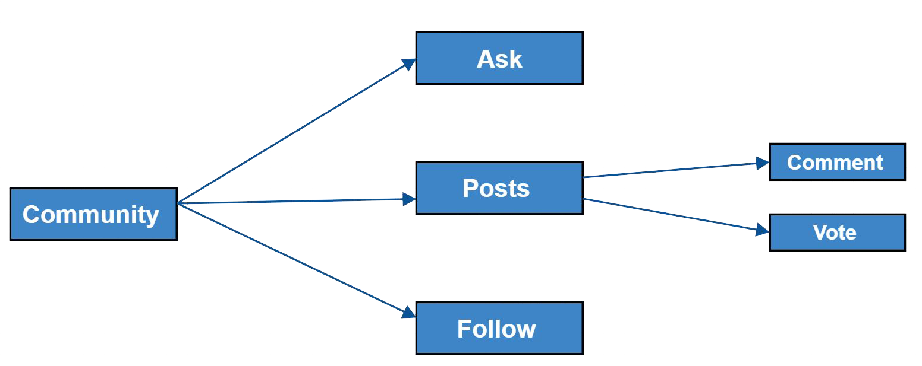
Community

Slide 24
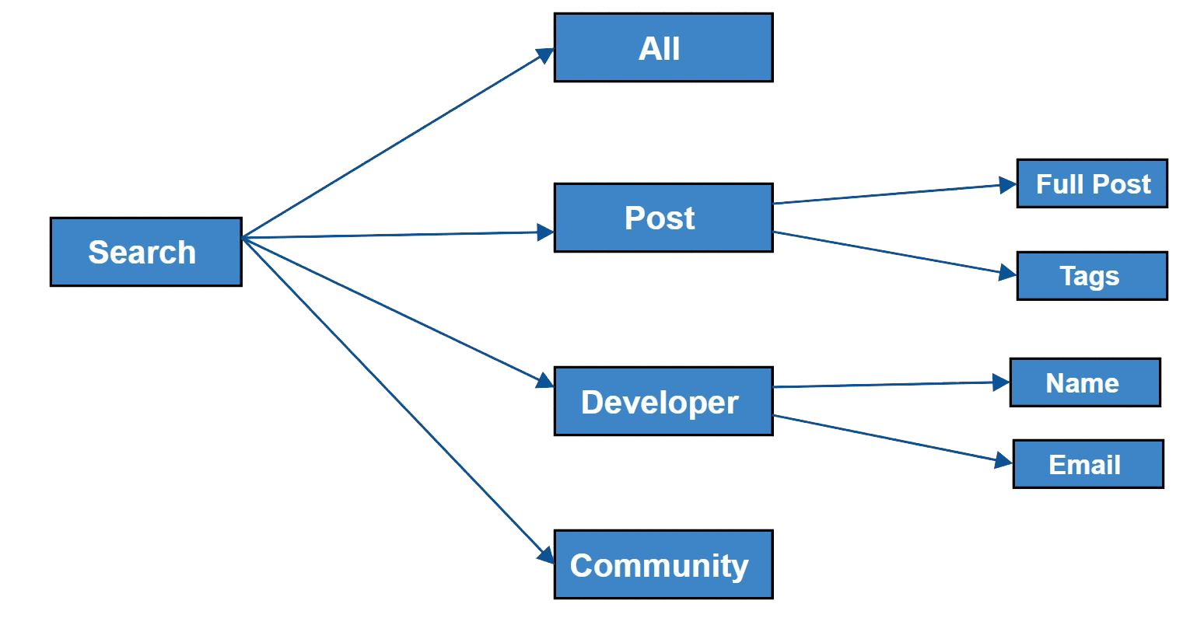
Search

Slide 25
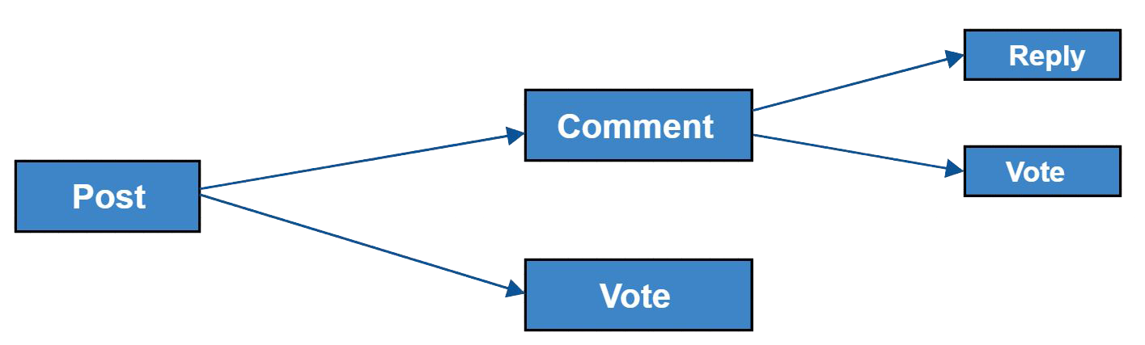
Post

Slide 26
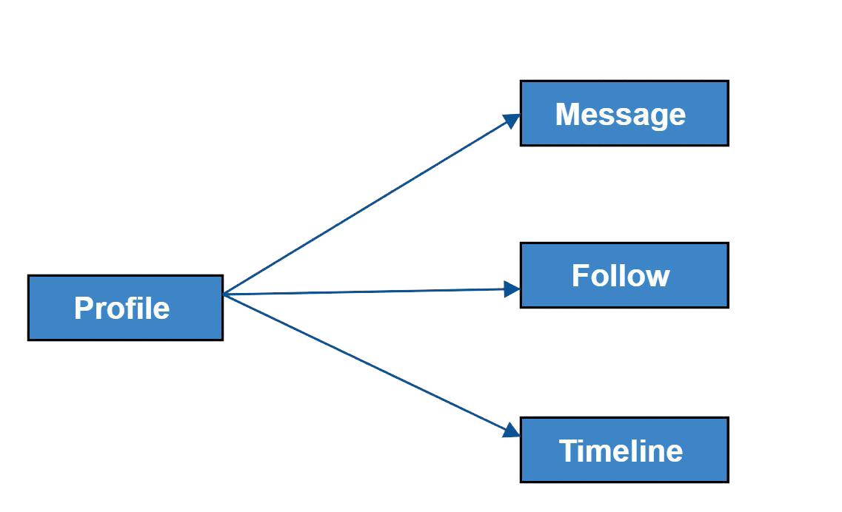
Message & Follow

Slide 27
Moqup
https://app.moqups.com/fardibkhan@gmail.com/KbepC0mHbv/view
https://app.moqups.com/sakib138/itwPNn8OlB/view

Slide 28
Diagrams
1.Context Diagram
2.Data flow Diagram
3.Use case diagram
4.Activity Diagram

Slide 29
Context Diagram
Rules for context Diagram
1. 0 level Diagram
2.start form 0
3.External Entities must written in capital letters

Slide 30

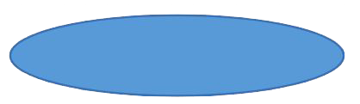
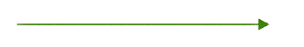
Symbol for context Diagram
External Entities
Process
Connectivity

Slide 31
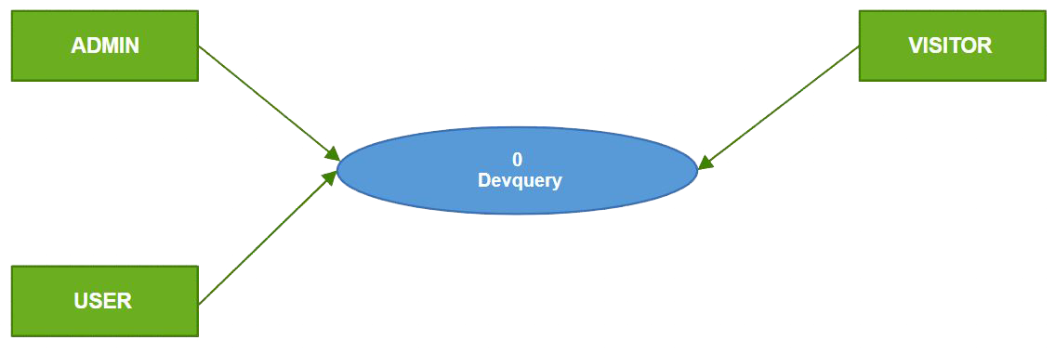
Context Diagram

Slide 32
Rules of Data flow Diagram
1.Each process has name and number
2.Database will be named capital letter
3.Database will be connected with only the process
4. Start from top left and ended at right bottom.
5. Database - database, external entity - database, external entity to external entity connection is not allowed.

Slide 33

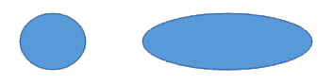
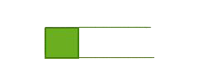
Symbol for Data flow diagram
External Entities
Process
Connectivity
Database

Slide 34
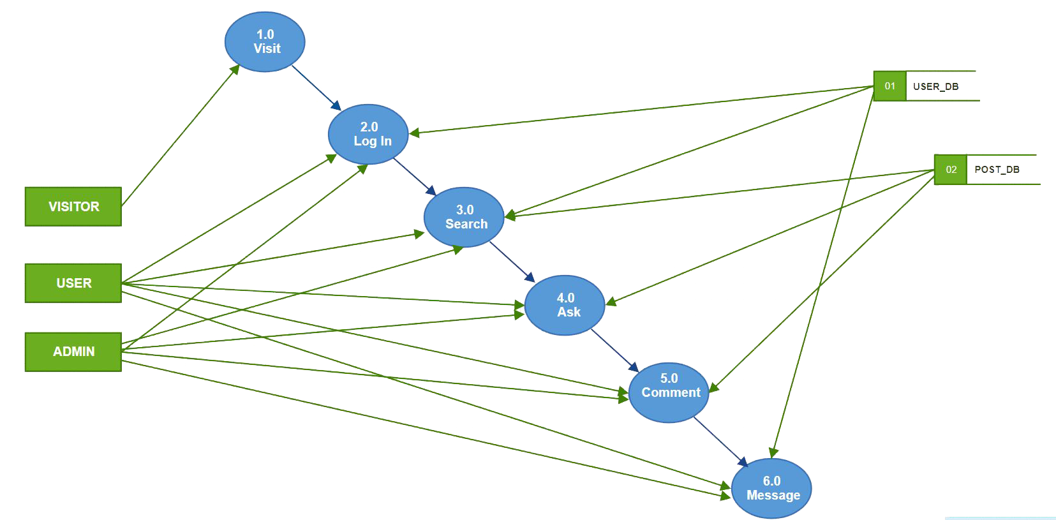
Data Flow Diagram

Slide 35
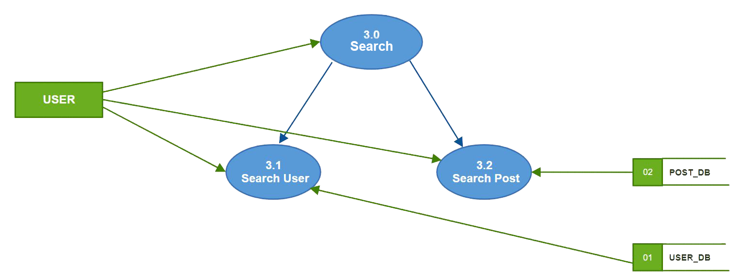
Level 1 and 2 Diagram

Slide 36
Use Case Diagram
Symbols for Use Case diagram
Use Case
Actor
Relationship
System

Slide 37
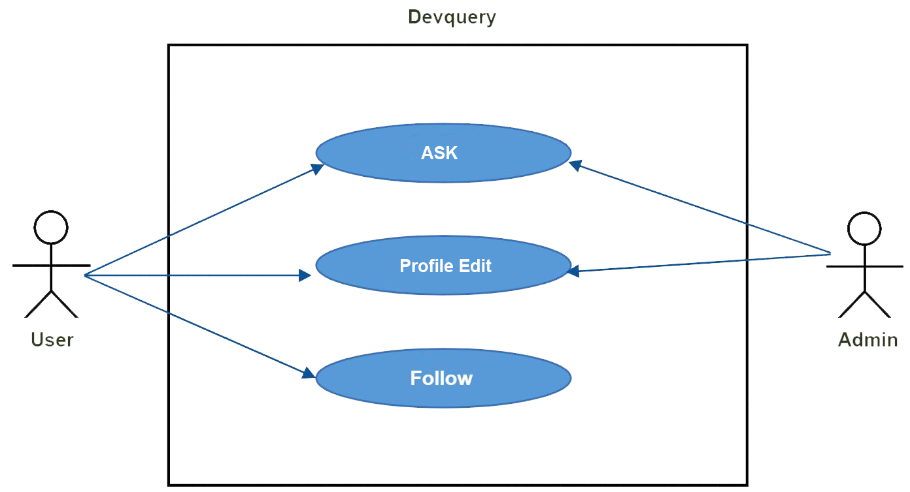
Diagram

Slide 38
Use Case Descriptive Form
Use case name and number
Primary Actor
Stakeholders and Interests
Pre-conditions
Success Scenario
Alternate Scenario
Post-conditions

Slide 39
Use case 1:Ask Question
Primary actor: User
Stakeholders and Interests:
User: Ask any question related with developer in devQuery platform
Admin: Check the Question is Spam or not .

Slide 40
Success Scenario:
Now user can ask question in his timeline.
User can reply to comment in their post.
User can comment in their own post.
User also can like or dislike the question.
User can like or dislike any comment.

Slide 41
Alternate Scenario:
*a: any time system can fail:
User restart the system, logs in and request recovery of prior state.
1(a) Spam may come into comments:
User can report for those spam message. Admin will handle this.

Slide 42
Pre-conditions:
User must have a user id.
User must have to log in with his or her user id.
Post-conditions:
Post will be save in database with his or her user id and password.

Slide 43
Use case 2:Profile Edit
Primary actor: User
Stakeholders and Interests:
User:
User can replace his or her old name, password and email by new name, password and Email.
User will able to change profile pic
Admin: Update database and check the user is fraud or not by asking old password.

Slide 44
Success Scenario:
User replace old name, password and email by new name, password and email.
All process will be happen if the old password is right.

Slide 45
Alternate Scenario:
*a: Any time system can fail:
User restart the system, logs in and request recovery of prior state.
2(a): Wrong password
Solution: Retype the correct password

Slide 46
Pre-conditions:
User have to visit DevQuery’s website
Must be log in with email and password
Have to go to his or her profile
Click on edit profile

Slide 47
Post-conditions:
User new Name, Email, Password save in database.
Now user will be identify by new name, password and email.

Slide 48
Activity Diagram:
Activity Diagram is a flowcharts that represent flows from one activity to another

Slide 49
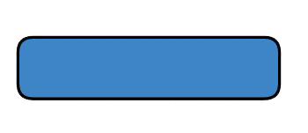

Symbols of Activity Diagram:
Start Symbol
Stop Symbol
Activity Symbol
Decision Symbol
Connector Symbol

Slide 50
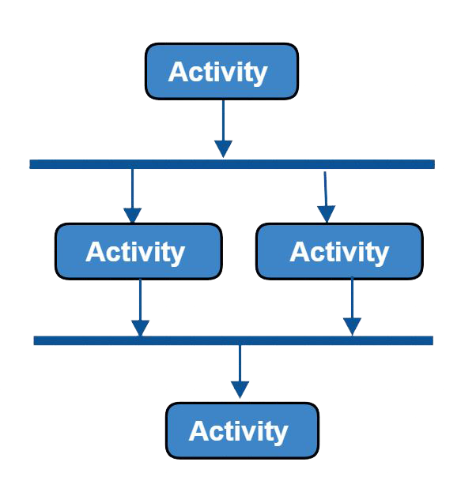
Symbols of Activity Diagram:
Multiple Process

Slide 51
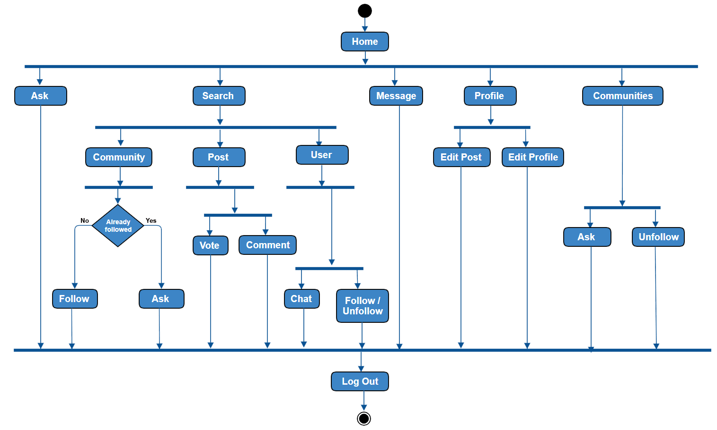
Activity diagram

Slide 52
Class Diagram
Class name has to be noun. Such as: user, seller, buyer, customer, product, admin etc.
There could be a relationship in inheritance.
Relationship between two classes
Events such as palenques description
Tangible things such as duster which has functions and attributes such as length, width and height.
A
B
C

Slide 53
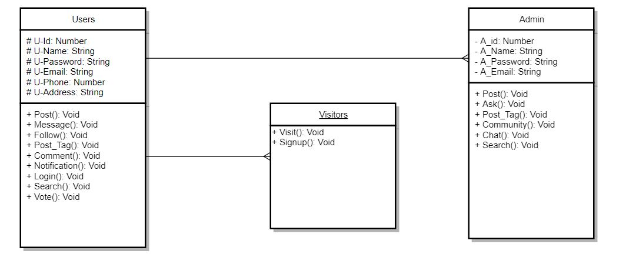
Class diagram

Slide 54
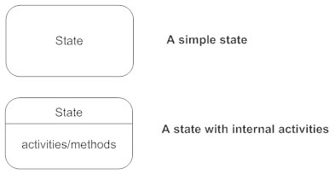


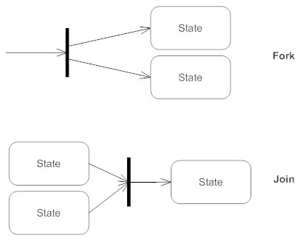
State diagram rules & symbols:
States States represent situations during the life of an object. You can easily illustrate a state in SmartDraw by using a rectangle with rounded corners.
Transition A solid arrow represents the path between different states of an object. Label the transition with the event that triggered it and the action that results from it. A state can have a transition that points back to itself.
Initial State A filled circle followed by an arrow represents the object's initial state.
Final State An arrow pointing to a filled circle nested inside another circle represents the object's final state.
Synchronization and Splitting of Control A short heavy bar with two transitions entering it represents a synchronization of control. The first bar is often called a fork where a single transition splits into concurrent multiple transitions. The second bar is called a join, where the concurrent transitions reduce back to one.

Slide 55
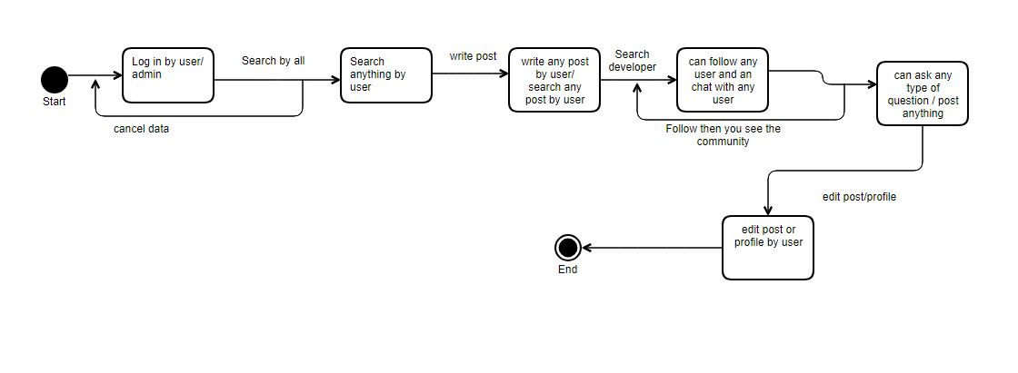
state diagram

Slide 56
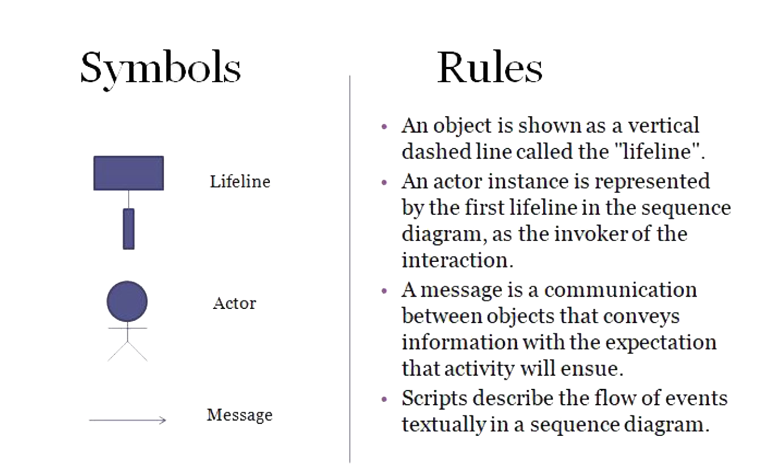
sequence diagram

Slide 57
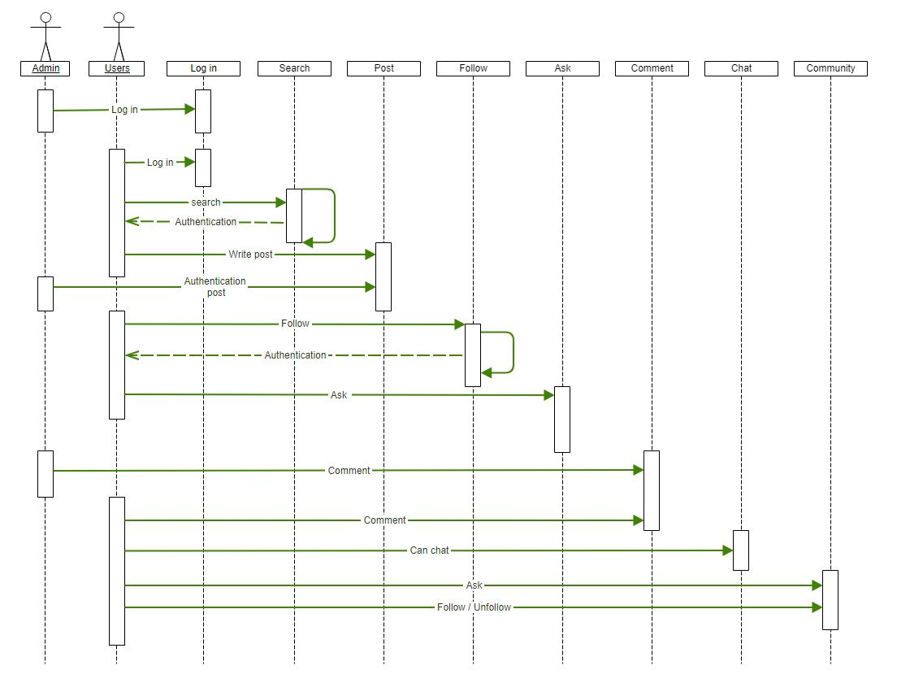
sequence diagram

Slide 58
Thank You

